Slide 1
Social Metrics Report
January XXXX

Slide 2





In 2023, the unbranded More Than MG (MTMG) social channels played a critical role in engaging with the MG social community
#MoreThanMG
Hashtag Use and
Views To Date
Top MTMG page for driving reach
Top MTMG page for driving engagement
Anticipated launch scheduled for
April 2023
TO COME
>XX million page reach to date (since January 2022) with XXK reach generated in January 2023 alone
>XX K engagements to date (since January 2022) with XX K engagements generated in January 2023 alone
N/A
KEY INSIGHT | In January 2023, compelling video content featuring real stories from those living with MG performed exceptionally well with the help of strategic media buys. Of note, Instagram reels performed exceptionally well,
reinforcing the importance of adapting social content to best align with the trends of each social platform

Slide 3
In January 2023, the MTMG Facebook page served as the most dominant platform for driving reach with social audiences
Platform Impact:
6,750,000=2023 GOAL
3,250=2023 GOAL
XXXXXXX
Page Reach
to date
(as of January 2022)
XXXXX
Monthly
Reach
3 New Pages Likes
XXX
Total Page
Likes
Content Engagement:
300,000=2023 GOAL
XXXXX
3-Second
Video Views
XX
Link Clicks
XXXXX
Page Reach
to date
(as of January 2022)
XXXXX
Monthly
Reach
DATA PULLED VIA FACEBOOK ON 1/31/23
Current Month

Slide 4
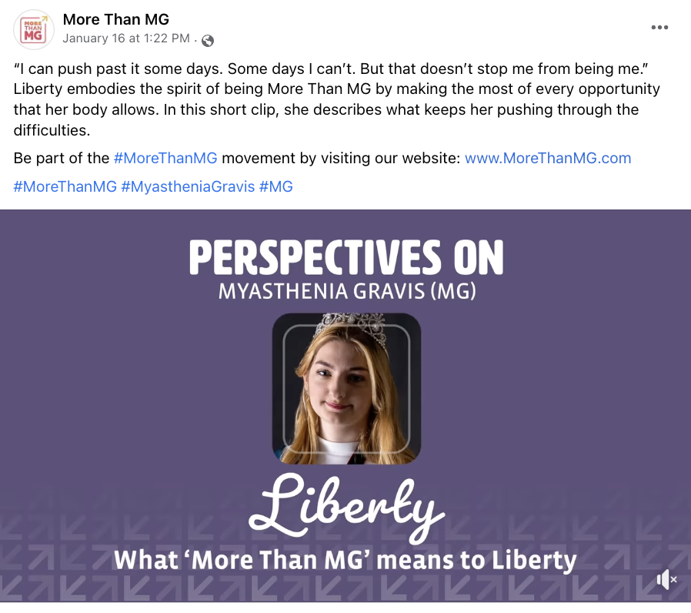
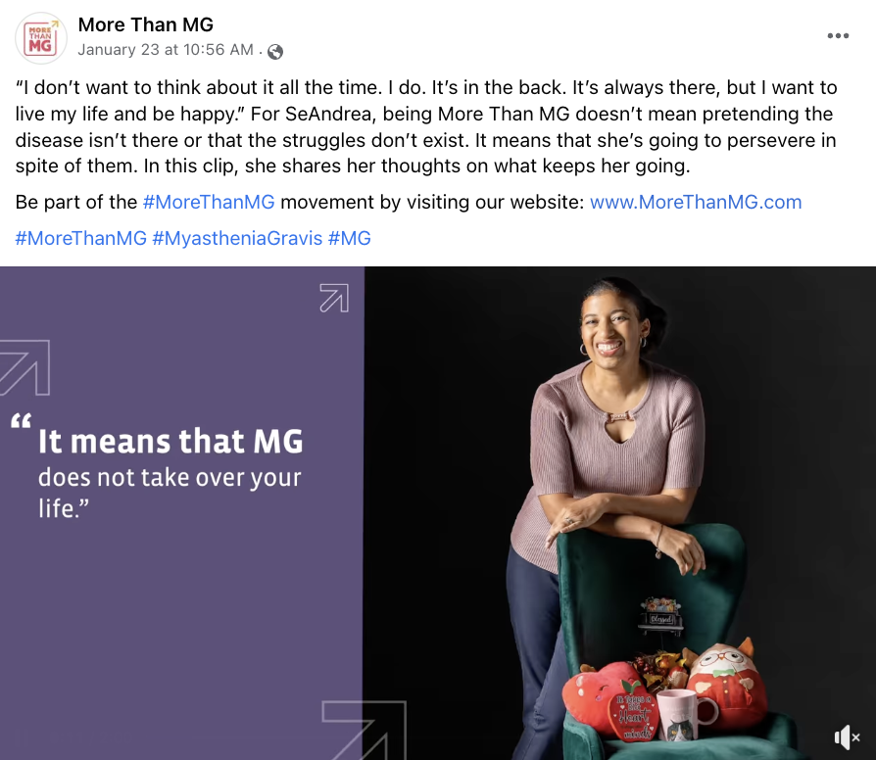
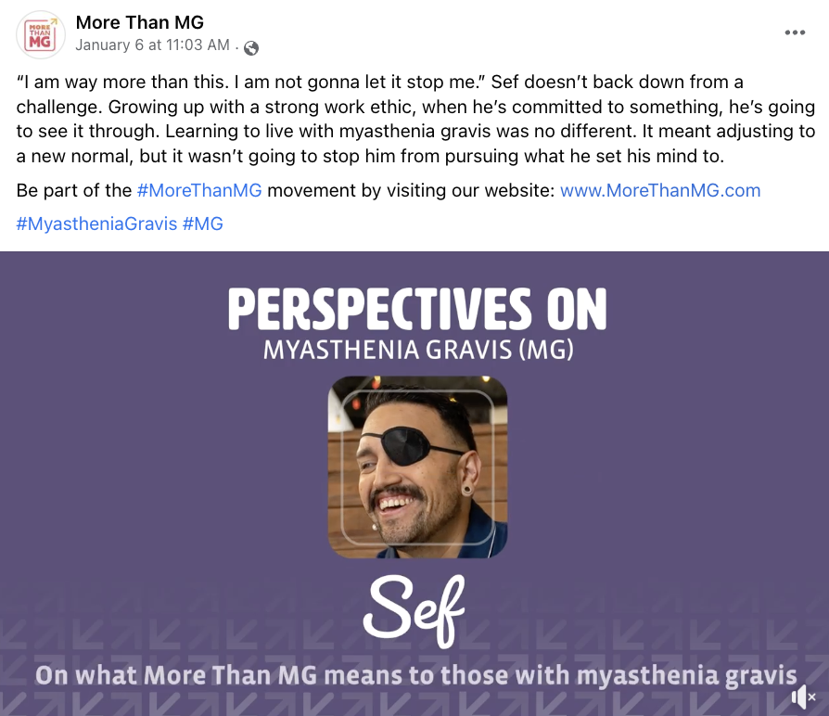
Top posts in January reinforce the importance of sharing real stories and experiences from those living with MG
Top Posts By Reach:
Reach | XXXX
3-Sec Video Views | XXXX
Clicks (all) | XX
Media Spend | $XX
Reach | XXXX
3-Sec Video Views | XXXX
Clicks (all) | XX
Media Spend | $XX
Reach | XXXX
3-Sec Video Views | XXXX
Clicks (all) | XX
Media Spend | $XX
DATA PULLED VIA FACEBOOK ON 1/31/23

